Slide 1


Software Quality Assurance
Planning and Tracking Software Quality
Yordan Dimitrov
Telerik Corporation
www.telerik.com

Slide 2

Table of Contents
What Is Software Quality?
Causes of Software Defects
What is Quality Assurance?
Improving the Software Quality

Slide 3

What Is Software Quality?
Source: http://blog.qatestlab.com

Slide 4
What is Software Quality?
Pressman's definition of "Software Quality“
Software quality measures how well software is designed (quality of design), and how well the software conforms to that design (quality of conformance)
Whereas quality of conformance is concerned with implementation, quality of design measures how valid the design and requirements are in creating a worthwhile product
Notes:
quality of conformance - Качество на съответствието
quality of design – Качество на дизайн
Софтуерното качество измерва колко добре е прокетиран един софтуер (Качество на дизайн), и колко добре софтуерът съответства на този дизайн (Качество на съответствието).
Качество на съответствието касае имплементацията, а Качеството на дизайна оценява колко дизайна и изискванията към софтуера отговарят на нуждите на клиента.
One of the challenges of software quality is that "everyone feels they understand it".^{[3]}
In addition to more software specific definitions given below, there are several applicable definitions of quality which are used in business.Quality_(business)#Definitions
Software quality may be defined as conformance to explicitly stated functional and performance requirements, explicitly documented development standards and implicit characteristics that are expected of all professionally developed software.
The three key points in this definition:
Software requirements are the foundations from which quality is measured.Lack of conformance to requirement is lack of quality.
Specified standards define a set of development criteria that guide the management in software engineering.If criteria are not followed lack of quality will usually result.
A set of implicit requirements often goes unmentioned, for example ease of use, maintainability etc.If software conforms to its explicit requirements but fails to meet implicit requirements, software quality is suspected.
A definition in Steve McConnell's Code Complete divides software into two pieces: internal and external quality characteristics. External quality characteristics are those parts of a product that face its users, where internal quality characteristics are those that do no

Slide 5

What is Software Quality? (2)
IEEE Definition of "Software Quality“
The degree to which a system, component, or process meets specified requirements
The degree to which a system, component, or process meets customer or user needs or expectations
Notes:
IEEE is the world’s largest professional association dedicated to advancing technological innovation and excellence for the benefit of humanity. IEEE and its members inspire a global community through IEEE's highly cited publications, conferences, technology standards, and professional and educational activities.

Slide 6

What is Software Quality? (3)
Steve McConnell's Code Complete defines two types of quality characteristics:
External
Those parts of a product that face its users
Internal
Not apparent to the user

Slide 7

External Characteristics
Correctness
Usability
Efficiency
Reliability
Integrity
Adaptability
Accuracy
Robustness
Notes:
Correctness – Степента, до която една система е свободен от грешки в своята спецификация, проектиране и изпълнение.
Usability - Лекотата, с която потребителите могат да учат и да използват система.
Efficiency - Минимално използване на системните ресурси, включително време, памет иизпълнение.
Reliability - Способността на системата да изпълнява функциите, необходими при посочените условия, когато това се налага, с дългогодишен средно време между отказите.
Integrity – Степента, до която една система от неоторизиран или незаконен достъп допрограмите и данните. Идеята за целостта включва ограничаване нанеоторизиран достъп до потребителя, както и гарантиране, че данните се влизаправилно, т.е. че таблици с паралелни данни се изменят успоредно, тази датаполета съдържат само валидни дати и т.н.
Adaptability - Степента, до която една система може да се използва, без промяна, вприложения или среди, различни от тези, за които е специално проектиран.
Accuracy - Степента, до която една система, както е изградена, е свободен от грешки,особено по отношение на количествените резултати. Точност се различава откоректност, това е определянето на това колко добре на система не работи, че епостроен за, а не дали тя е построена правилно.
Robustness - Степента, до която една система продължава да функционира при наличието на стресови условия на околната среда.

Slide 8
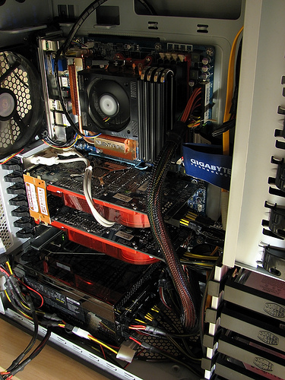
Internal Characteristics
Maintainability
Flexibility
Portability
Reusability
Readability
Testability
Understandability
Source: flickr.com
Notes:
Maintainability - Лекотата, с която можете да модифицирате системния софтуер да се промениили да добавите възможности, подобряване на резултатите или да се коригира дефекта.
Flexibility - Степента, в която можете да променяте системите за употреба или среди, различни от тези, за които е специално проектиран.
Portability - Лекотата, с която можете да промените системата да работи в среда, различна от тази, за която е специално проектиран.
Reusability - Степента, в която и лекотата, с която можете да използвате части от системата в други системи.
Readability - Лекотата, с която можете да прочетете и разберете сорс кода на системата,особено в подробни-декларация ниво.
Testability - Степента, в която можете да единица-тест и за тест системата; степента, в коятоможете да проверите дали системата отговаря на неговите изисквания.
Understandability - Лекотата, с която можете да разберете система както на система-организационни и нива на подробни-декларация. Разбираемост е свързано с последователносттана системата в по-общ план от четивността прави.

Slide 9
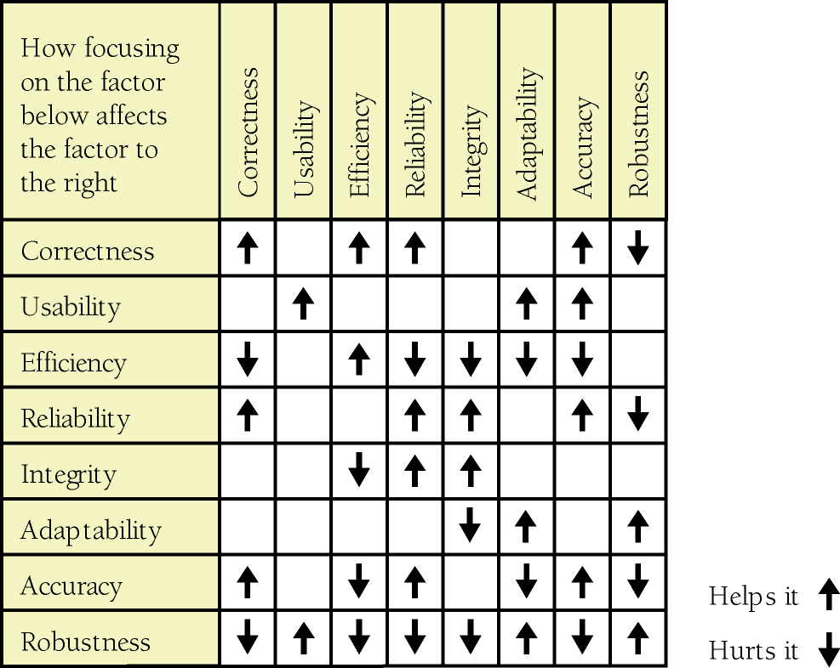
Dependencies
Notes:
Разликата между вътрешните и външни характеристики не е напълно ясна, защото в известна степен вътрешни характеристики засягат външни такива. Софтуер, който не е Четим или Maintainable възпрепятства способността Ви да коригирате дефекти, което от своя страна се отразява на външните характеристики на коректност и надеждност.
Софтуер, който не е Flexible, неможе да бъде подобрено в отговор на потребителските въпроси, които от своя страна влияе на външната характеристика на Usability.
Въпросът е, че някои качествени характеристики се подчертават, за да улесни живота на потребителя, а някои са подчертани да направят живота по-лесен за програмист.Опитайте се да разберете кой е кой и кога и как тези характеристикивзаимодействат. Опитът да се максимизират определени характеристики неизбежно противоречие с опит да се максимизират други. Намирането на оптимално решение от поредица от конкуриращи се цели е една дейност, която прави софтуер за развитие на истински инженерни дисциплини. Фигурата показва начина, по който с акцент върху някои външни характеристики за качество, засяга други.

Slide 10

Reality Check…
Q: So, how does that lists help us with SQA?
A: Most, if not all, of those factors should be covered explicitly in the software requirements document
A: Measuring those factors tell us where we need improvement

Slide 11

Causes of Software Defects
Source: http://codingcreativity.blogspot.com

Slide 12



Causes of Software Defects
A human being can make an error (mistake)
Errors produce defects
Defects are faults / bugs in the program code, or in a document
If a defect in code is executed, that might cause a failure:
Fail to do what it should do
Do something it shouldn’t

Slide 13
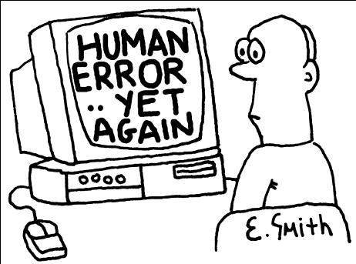

Causes of Software Defects (2)
The human factor
Humans make mistakes
Poor training
Time pressure
Code complexity
Complexity of infrastructure
Changing technologies

Slide 14
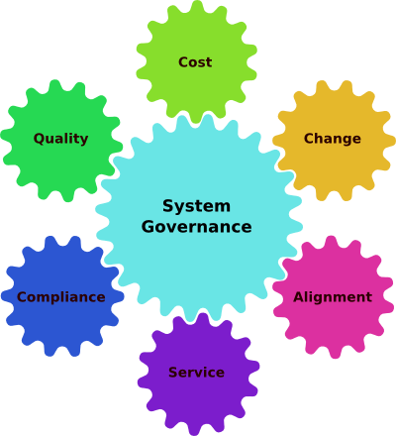
Causes of Software Defects (3)
Organizational factors
Inefficient team communication
Incomplete data specifications
Unclearly defined requirements
Incorrect project documentation

Slide 15


Causes of Software Defects (4)
Environmental conditions
Radiation
Magnetism
Electronic fields
Pollution
Etc.
These can change the hardware conditions

Slide 16

What is Quality Assurance?

Slide 17
What Is Software Quality Assurance?
IEEE Definition of "Software Quality Assurance“
A planned and systematic pattern of all actions necessary to provide adequate confidence that an item or product conforms to established technical requirements
A set of activities designed to evaluate the process by which the products are developed or manufactured. Contrast with quality control
Notes:
Планниран модел на всички действия за осигуряване на необходимата сигурност че продукта отговаря на зададените технически изисквания.
Множество от действия оценяващи процеса по който продукта се разработва. Но това е различно от контрол на качеството.
SQA encompasses the entire software development process, which includes processes such as requirements definition, software design, coding, source code control, code reviews, change management, configuration management, testing, release management, and product integration. SQA is organized into goals, commitments, abilities, activities, measurements, and verifications^{[1]}.
Another definition by Dr. Tom DeMarco says "a product's quality is a function of how much it changes the world for the better."^{[5]} This can be interpreted as meaning that user satisfaction is more important than anything in determining software quality.^{[1]}
Another definition, coined by Gerald Weinberg in Quality Software Management: Systems Thinking, is "Quality is value to some person." This definition stresses that quality is inherently subjective - different people will experience the quality of the same software very differently. One strength of this definition is the questions it invites software teams to consider, such as "Who are the people we want to value our software?" and "What will be valuable to them?"

Slide 18

What Is Software Quality Assurance? (2)
Software quality assurance is a planned and systematic program of activities
Designed to ensure that a system has the desired characteristics
Source: http://www.askaboutvalidation.com/

Slide 19

The Role of SQA
What is the role of SQA in the software development process?
Monitoring the software engineering processes
Reducing the risk of problems
Ensuring the quality of the software
Providing information for decision-making
Help meeting standards:
Contractual or legal requirements
Industry-specific standards

Slide 20
QA vs. Testing
Requirements
Planning
Development
Testing
Deployment
Software Development Lifecycle
Software Quality Assurance
Software Testing

Slide 21

Improving the Software Quality

Slide 22

Techniques for Improving Software Quality
Software-quality objectives
Explicit quality-assurance activity
Testing strategy
Software-engineering guidelines
Informal technical reviews
Formal technical reviews
External audits
Source: http://www.enjoyhelpsmile.org/

Slide 23

Improve Development Process
Change-control procedures
Measurement of results
Prototyping

Slide 24
Setting Objectives
Objectives Team Was Told to Optimize | Minimum memory use | Most readable output | Most readable code | Least code | Minimum programming time
Minimum memory | 1 | 4 | 4 | 2 | 5
Output readability | 5 | 1 | 1 | 5 | 3
Program readability | 3 | 2 | 2 | 3 | 4
Least code | 2 | 5 | 3 | 1 | 3
Minimum programming time | 4 | 3 | 5 | 4 | 1
Programmers have high achievement motivation:
They will work to the objectives specified, but they must be told what the objectives are
Objectives conflict and it's generally not possible to do well on all of them

Slide 25
Relative Effectiveness
Removal Step | Lowest Rate | Modal Rate | Highest Rate
Informal design reviews | 25% | 35% | 40%
Formal design inspections | 45% | 55% | 65%
Informal code reviews | 20% | 25% | 35%
Formal code inspections | 45% | 60% | 70%
Modeling or prototyping | 35% | 65% | 80%
Personal desk-checking of code | 20% | 40% | 60%
Unit test | 15% | 30% | 50%
New function (component) test | 20% | 30% | 35%
Integration test | 25% | 35% | 40%
Regression test | 15% | 25% | 30%
System test | 25% | 40% | 55%
Low-volume beta test (<10 sites) | 25% | 35% | 40%
High-volume beta test (>1,000 sites) | 60% | 75% | 85%
Notes:
The most interesting facts that this data reveals is that the modal rates don't rise above 75 percent for any single technique and that the techniques average about 40 percent. Moreover, for the most common kinds of defect detection—unit testing and integration testing—the modal rates are only 30–35 percent. The typical organization uses a test-heavy defect-removal approach and achieves only about 85 percent defect removal efficiency. Leading organizations use a wider variety of techniques and achieve defect-removal efficiencies of 95 percent or higher (Jones 2000).

Slide 26
Higher Defect Detection Rate
Combination of Techniques
Extreme programing Techniques
Removal Step | Lowest Rate | Modal Rate | Highest Rate
Informal design reviews (pair programming) | 25% | 35% | 40%
Informal code reviews (pair programming) | 20% | 25% | 35%
Personal desk-checking of code | 20% | 40% | 60%
Unit test | 15% | 30% | 50%
Integration test | 25% | 35% | 40%
Regression test | 15% | 25% | 30%
Expected cumulative defect-removal efficiency | ~74% | ~90% | ~97%
Notes:
The most interesting facts that this data reveals is that the modal rates don't rise above 75 percent for any single technique and that the techniques average about 40 percent. Moreover, for the most common kinds of defect detection—unit testing and integration testing—the modal rates are only 30–35 percent. The typical organization uses a test-heavy defect-removal approach and achieves only about 85 percent defect removal efficiency. Leading organizations use a wider variety of techniques and achieve defect-removal efficiencies of 95 percent or higher (Jones 2000).

Slide 27

Recommended Combination
Formal inspections of all requirements, all architecture, and designs for critical parts of a system
Modeling or prototyping
Code reading or inspections
Execution testing

Slide 28
The General Principle
The General Principle of Software Quality is that improving quality reduces development costs
The industry-average productivity for a software product is about 10 to 50 of lines of delivered code per person per day
Debugging and associated refactoring and other rework consume about 50 percent of the time on a traditional, naive software-development cycle
Notes:
Understanding this principle depends on understanding a key observation: the best way to improve productivity and quality is to reduce the time spent reworking code, whether the rework arises from changes in requirements, changes in design, or debugging. The industry-average productivity for a software product is about 10 to 50 of lines of delivered code per person per day (including all noncoding overhead). It takes only a matter of minutes to type in 10 to 50 lines of code, so how is the rest of the day spent?
The single biggest activity on most projects is debugging and correcting code that doesn't work properly. Debugging and associated refactoring and other rework consume about 50 percent of the time on a traditional, naive software-development cycle. (See Section 3.1, "Importance of Prerequisites," for more details.) Reducing debugging by preventing errors improves productivity. Therefore, the most obvious method of shortening a development schedule is to improve the quality of the product and decrease the amount of time spent debugging and reworking the software.

Slide 29
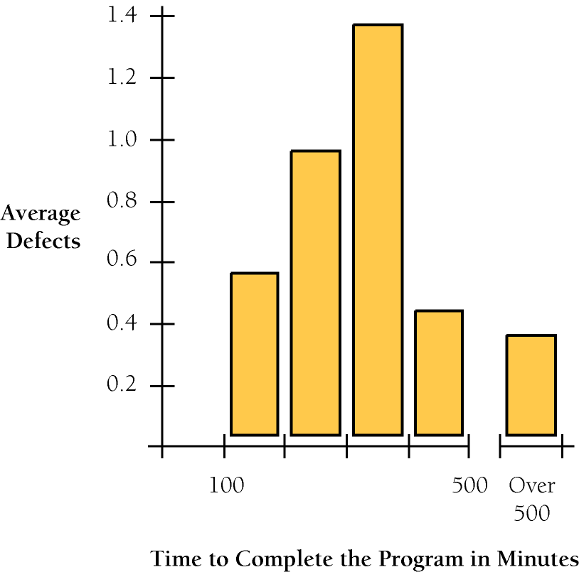
What About the Time?
Writing software without defects takes less time
Notes:
Software projects with the lowest levels of defects had the shortest development schedules and the highest development productivity…. software defect removal is actually the most expensive and time-consuming form of work for software (Jones 2000).
The same effect holds true at the small end of the scale. In a 1985 study, 166 professional programmers wrote programs from the same specification. The resulting programs averaged 220 lines of code and a little under five hours to write. The fascinating result was that programmers who took the median time to complete their programs produced programs with the greatest number of errors. The programmers who took more or less than the median time produced programs with significantly fewer errors (DeMarco and Lister 1985). Figure 20-2 graphs the results.
The two slowest groups took about five times as long to achieve roughly the same defect rate as the fastest group. It's not necessarily the case that writing software without defects takes more time than writing software with defects. As the graph shows, it can take less.
Compared to the traditional code-test-debug cycle, an enlightened software-quality program saves money. It redistributes resources away from debugging and refactoring into upstream quality-assurance activities. Upstream activities have more leverage on product quality than downstream activities, so the time you invest upstream saves more time downstream. The net effect is fewer defects, shorter development time, and lower costs.

Slide 30
Software Quality Assurance
?
?
?
?
?
Questions?
?
?
?
?
?
http://academy.telerik.com

